Slide 1

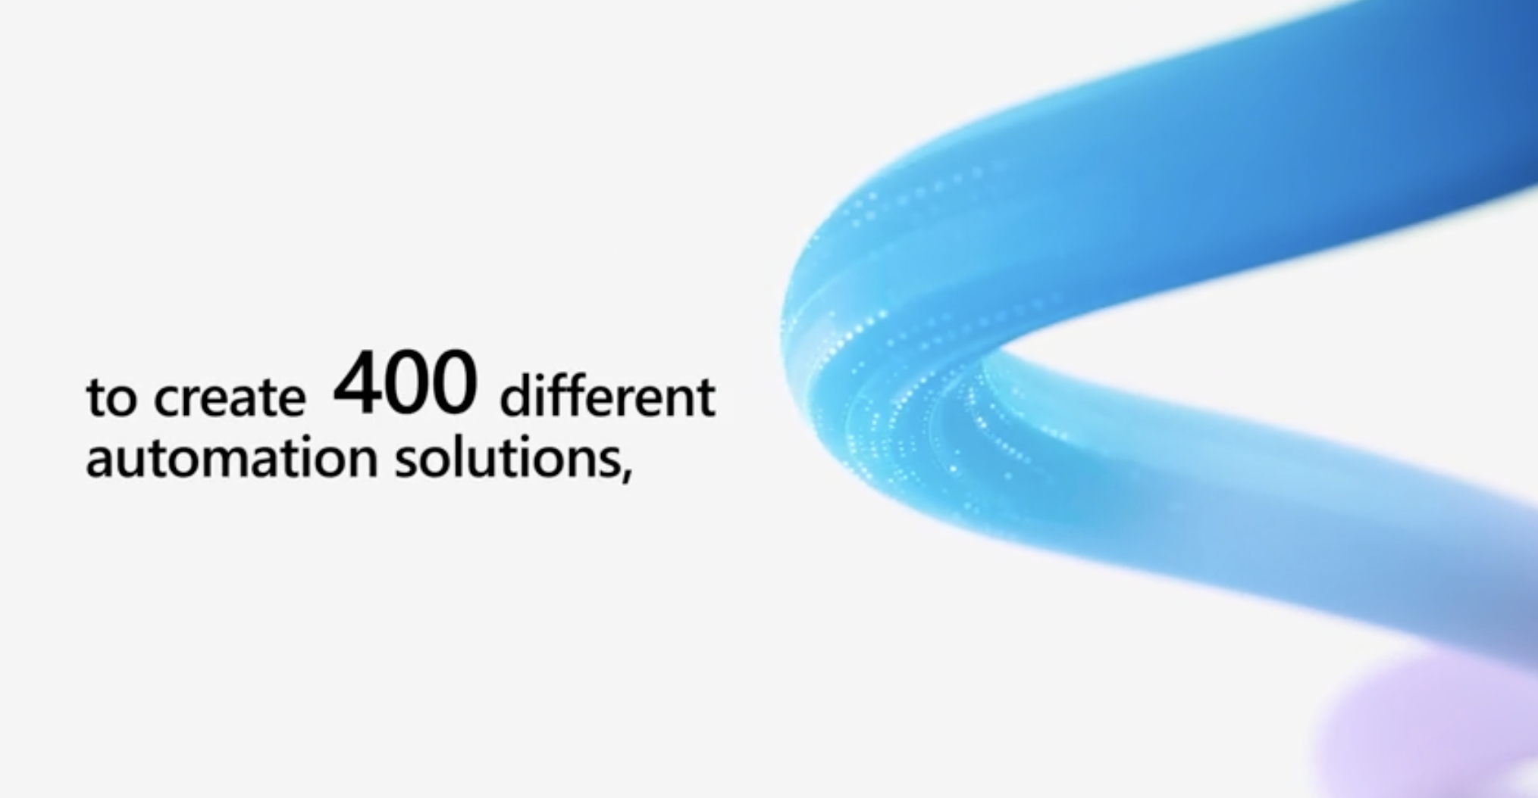

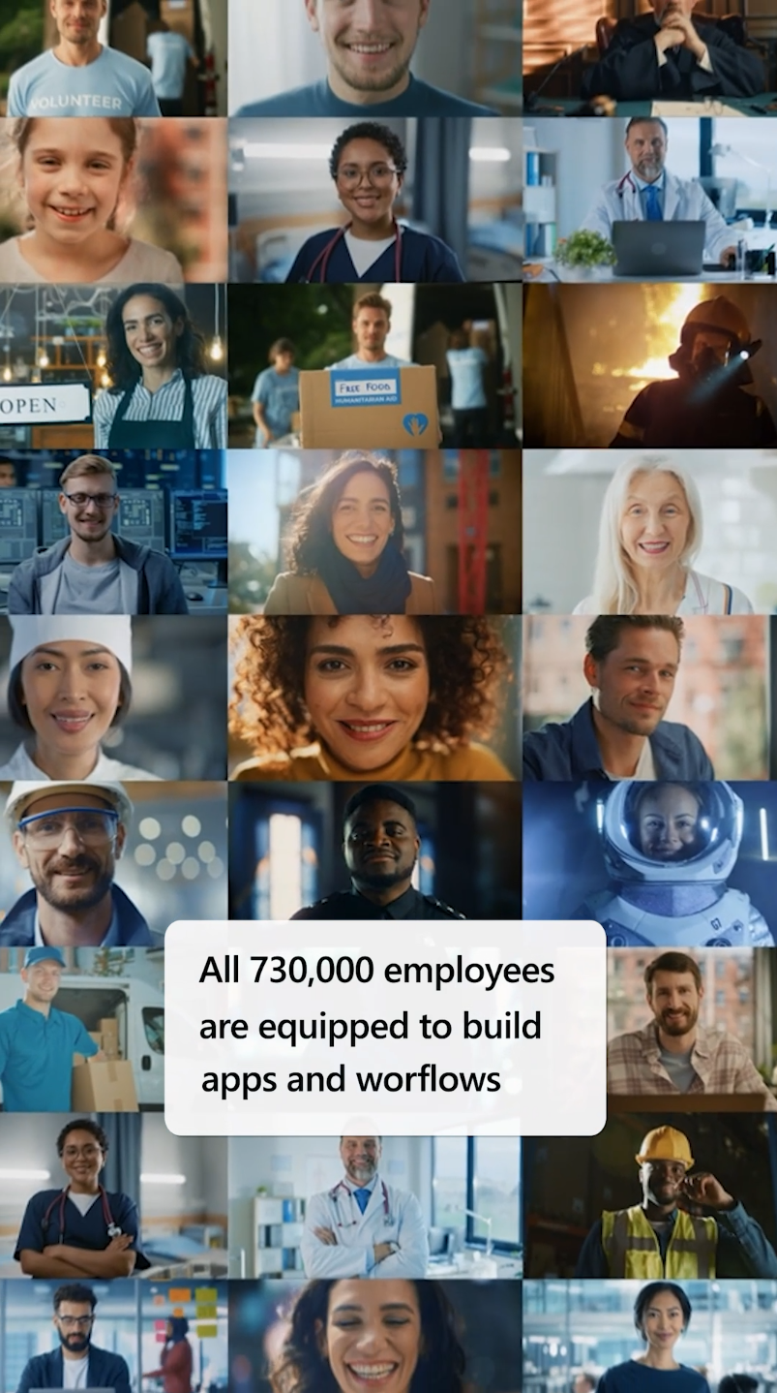
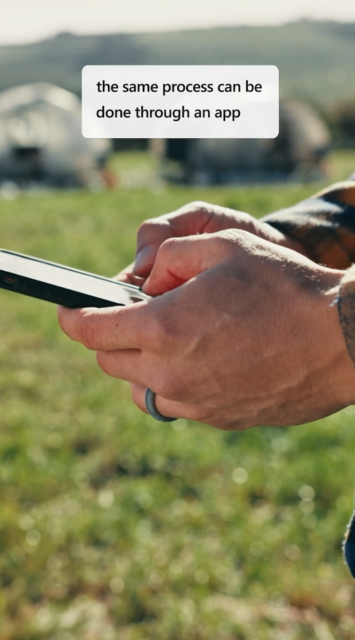
Customer Stories for Power Platform
Microsoft Power Platform team wanted to convert ~20 of their written customer stories into engaging video content. Their goal was to produce relatable stories that showcased the significant success their customers experienced using Power Platform apps.
Our Work
Aligned on what customer stories to highlight and pulled out essential details into impactful ~1:30 min video scripts
Storyboarded for the first customer story, establishing a cohesive look and feel for the entire series
Created motion graphics from provided Figma screens that resonated with the Power Platform brand
Combined recorded voiceovers and background music to enhance the narrative flow
Sourced and integrated relevant stock footage and customer-provided clips
Worked closely with the client and customer, incorporating feedback and securing approvals at each stage of production
Optimized full customer stories into mobile-ready dimensions for social media
Created six bite-sized social GIFs using motion graphics to convey six stats of customers' success
The Result
Through a blend of planning, creative execution, and collaborative effort, we successfully brought the Microsoft Power Platform's customer stories to life, amplifying their reach and impact in a visually compelling way

Slide 2

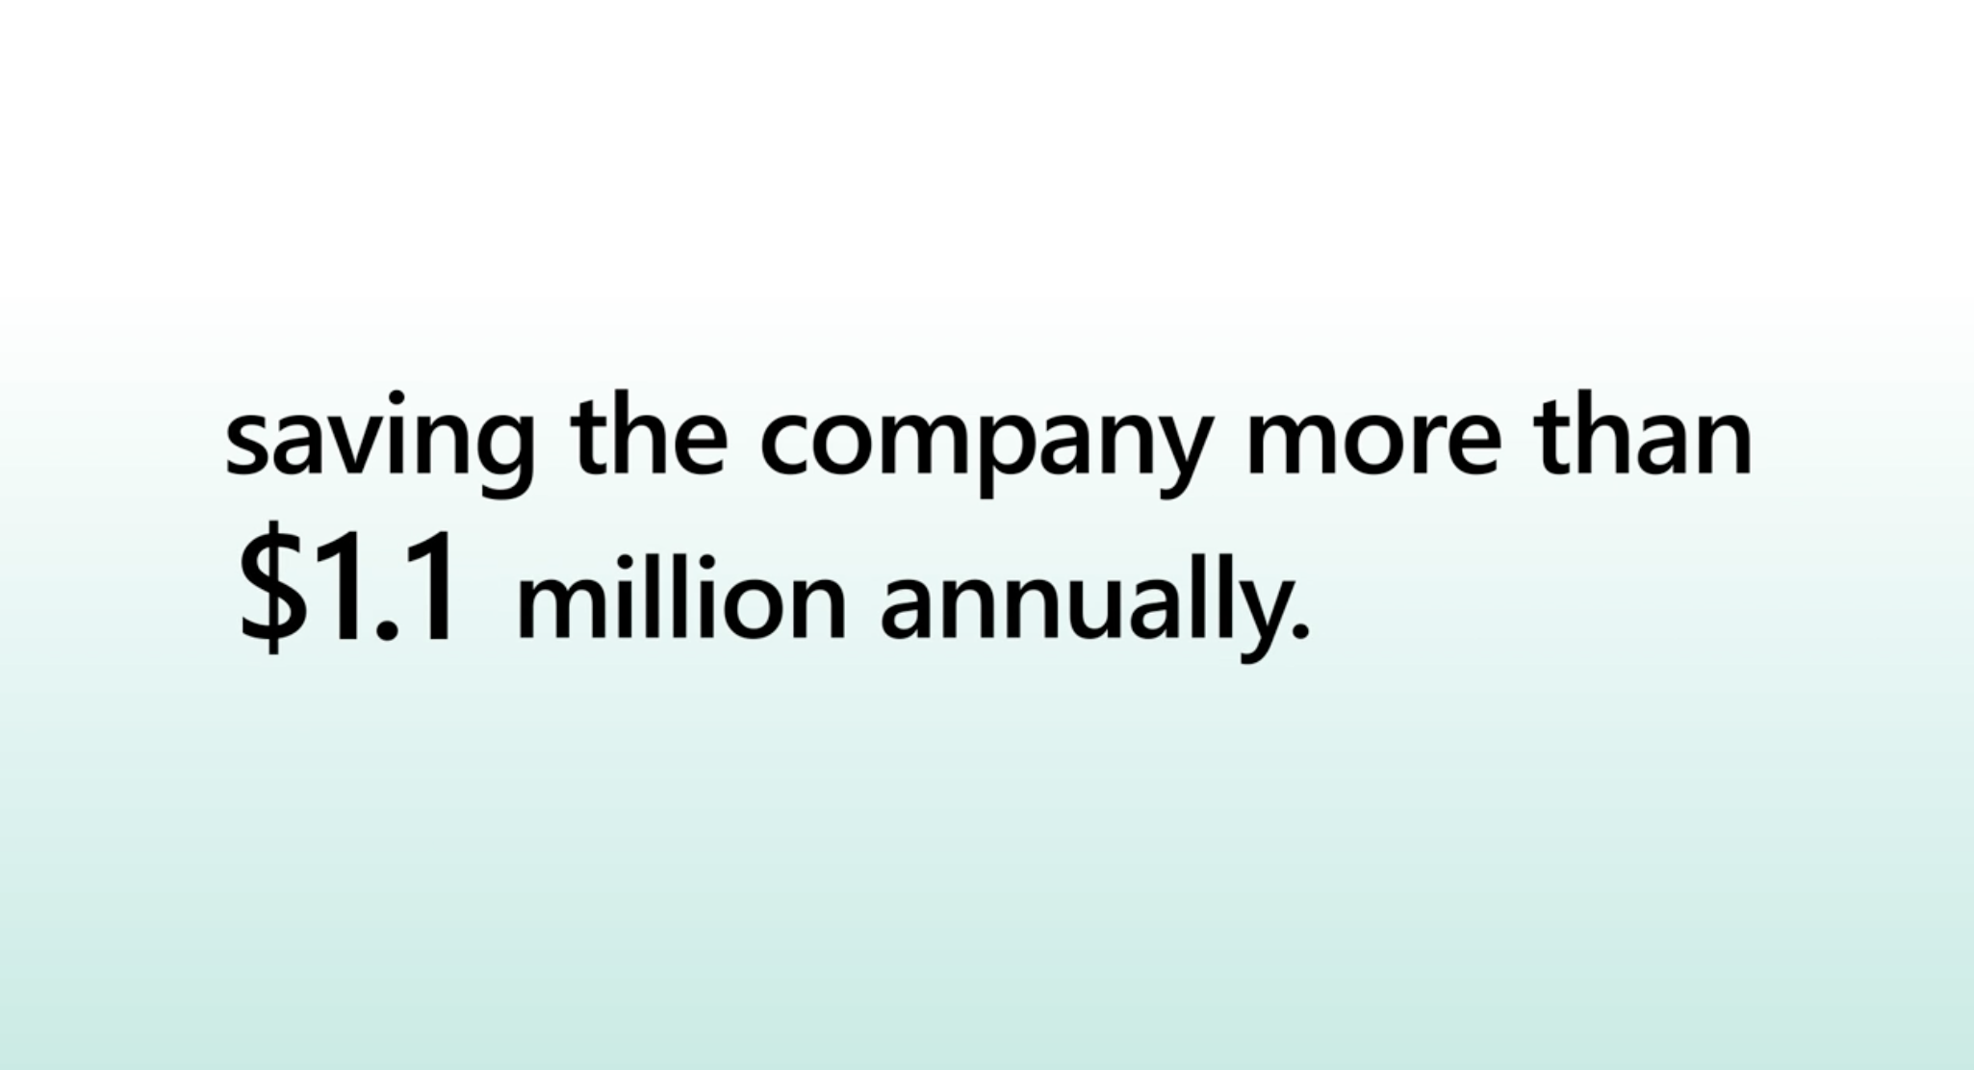

Customer Success Stories
A leading technology company team wanted to convert ~20 of their written customer stories into engaging video content. Their goal was to produce relatable stories that showcased the significant success their customers experienced using their sevices.
Our Work
Aligned on what customer stories to highlight and pulled out essential details into impactful ~1:30 min video scripts
Storyboarded for the first customer story, establishing a cohesive look and feel for the entire series
Created motion graphics from provided screens that resonated with the company's brand
Combined recorded voiceovers and background music to enhance the narrative flow
Sourced and integrated relevant stock footage and customer-provided clips
Worked closely with the client and customer, incorporating feedback and securing approvals at each stage of production
Optimized full customer stories into mobile-ready dimensions for social media
Created six bite-sized social GIFs using motion graphics to convey six stats of customers' success
The Result
Through a blend of planning, creative execution, and collaborative effort, we successfully brought the company's customer stories to life, amplifying their reach and impact in a visually compelling way

